Slide 1

LECTURE 10
TOEIC SPEAKING
Questions 4-5-6

Slide 2
01
Quick guide

Slide 3
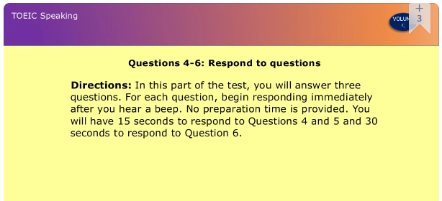

Slide 4
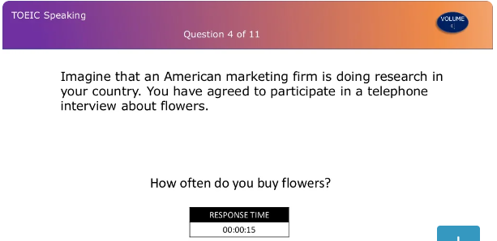
Sample questions

Slide 5
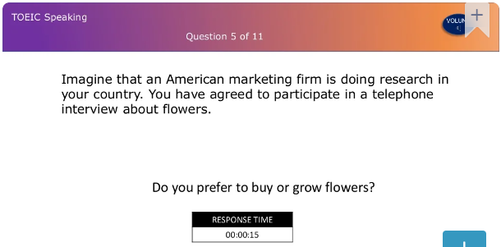
Sample questions

Slide 6
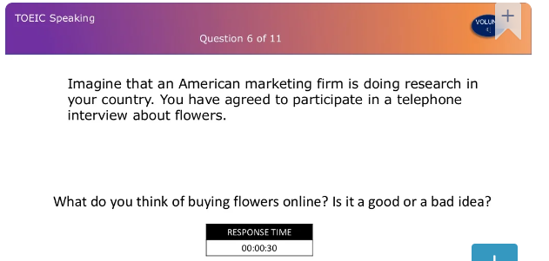
Sample questions

Slide 7

Common topics
1. Holidays and travel
2. Shopping
3. Health and sports
4. Dining and entertainment
5. News
6. Housing
7. Friends and family, etc.

Slide 8
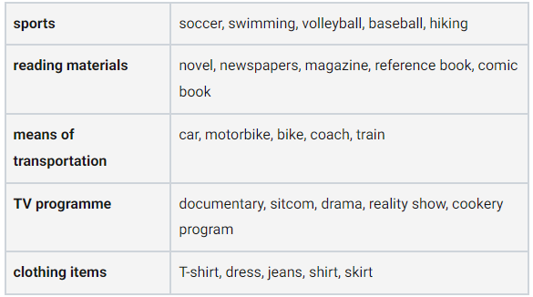
Topics and relevant content

Slide 9
Marking criteria
Pronunciation, Stress, Intonation
Vocabulary
Grammar
Cohesion of ideas
Relevance and Completeness of Content

Slide 10
Things to remember
1. Quickly analyze prompt and questions. Key words in prompt? Needed information to response?
2. Think of keywords that helps to answer.
3. Begin your answer with a topic sentence restating prompt, then add your own information.
4. Explain main reason & provide personal details to support.
‘

Slide 11
02
Walk through

Slide 12
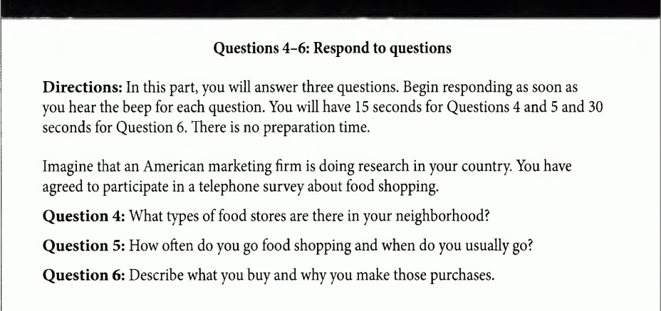
Sample questions – P.27

Slide 13
DISCUSSION - PAIRWORK
What is the main topic of these questions ?
Brainstorm as many vocabulary about the topic as possible.

Slide 14

Listen to the sample answer
Take note as many words and phrases as you can hear
4. supermarket
5. once/ twice a week, Thursday evening, 8-9 pm
6. fresh fruits and vegetables, organic food, I like to eat healthy food

Slide 15
03
Get it right
Tips to answer correctly

Slide 16
Types of questions
&
Ways to respond

Slide 17
1. What kind/ type of …. ?
Ex:
What types of food store are there in your neighborhood ?
“Well there are many/ a lot of….. but ….”
Use synonyms in your answer

Slide 18
2. Why do you …?
Ex:
Why do you like watching movie?
Because / since/ As/ Due to/ Thanks to …
Use synonyms to paraphrase the questions

Slide 19
3. How often do you ….?
Ex:
How often do you go to the cinema?
Always, usually, often, sometimes, occasionally…
Once a week , twice a month, 3 times …
Because / since/ As/ Due to/ Thanks to …

Slide 20
4. How long have you …?
Ex:
How long have you been interested in movies?
I have + P2 … for/ since…

Slide 21
5. What do you think about/of...?
Ex:
What do you think of the price of movies in your city?
→ I think/ I believe/ I feel/ I suppose/ In my opinion ….

Slide 22
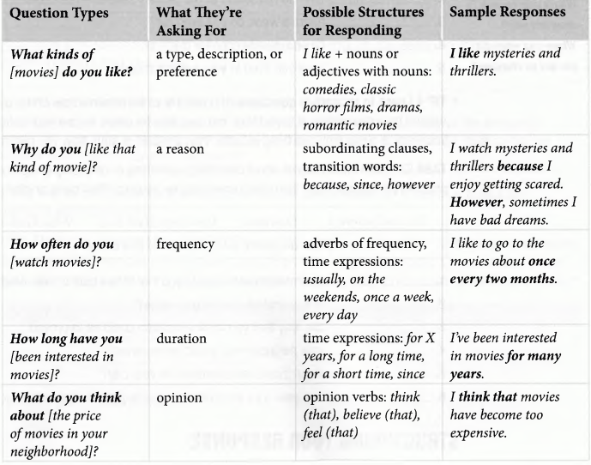
SUM-UP

Slide 23
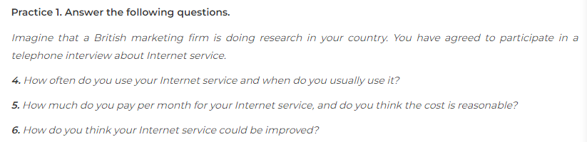
SPEAKING TIME

Slide 24
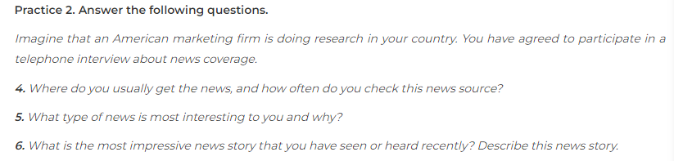
    HOMEWORK

Slide 25
Goodbye!
See you again!

